Slide 1

Cybersecurity & Artificial Intelligence
Enhancing Cyber Security Operations with Artificial Intelligence

Slide 2

Introduction:
John Kuria
Jack Ojee
Senior SOC Analyst
Security Engineer
5+ years in cybersecurity, specializing in SOC and Threat Analysis.
Software development, machine learning & cyber security.
Vision
Passionate about bridging the gap between AI potential and practical implementation in security.

Slide 3

Agenda
1
AI, ML & LMs
2
AI in SOC
Understanding the core difference between AI, ML and LMs.
Incident Response
Threat Detection and Response
Threat-Intelligence Curation
UEBA
3
Limitations
4
Key Takeaways
Addressing the hurdles and considerations in implementing AI for SOCs.
Summarizing crucial insights for leveraging AI in cybersecurity effectively.

Slide 4
Introduction:
Can AI truly make SOCs Autonomous?

Slide 5
AI Vs Machine Language and LLMs
AI
Machine Learning
Large Language Models (LLMs)
Broad term that encompasses enabling machines to accomplish tasks that would normally require human intelligence.
ML and Generative AI are 2 sub-categories of AI.
Subset of AI.
Algorithms that can learn from data.
Trained on a set of data to make predictions without being programmed.
Supervised and Unsupervised ML
Text-oriented Generative AI since ChatGPT’s intro in November 2022.
Trained on Large data sets taken from public/private data collections of Natural language to process and generate human-like text.

Slide 6
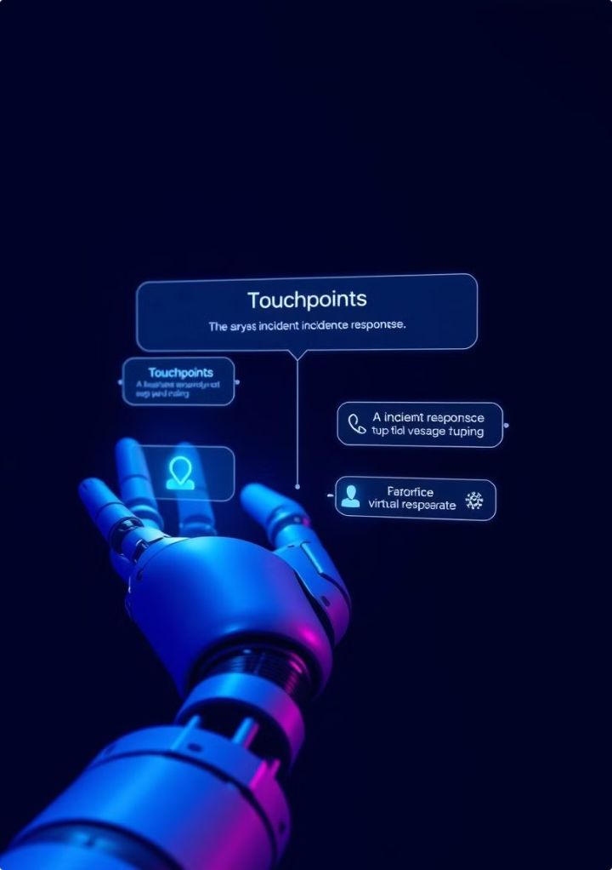
Use of AI in SOC: Incident Response
1
Problem
Information overload
Overwhelming False-Positives
Backlogs and Burnout.
2
Traditional Approach
Fine-tuning of SIEM rules
3
AI Approach
RAG (Retrieval Augmented Generation) for generation of emails to escalate incidents.
Faster Incident Response and Recovery
Faster Validation and enrichment of threat intelligence.

Slide 7

Use of AI in SOC: Threat Detection
1
Problem
Traditional systems struggle to detect sophisticated, evolving threats in real-time.
2
Traditional Approach
Rule-based systems and manual analysis, often leading to false positives and missed threats.
3
AI Approach
Machine learning models analyze patterns to identify anomalies and potential threats more accurately.
Real-time detection, prevention and mitigation.

Slide 8

Use of AI in SOC: Threat Intelligence
1
Problem
Overwhelming volume of threat data makes timely analysis challenging.
2
Traditional Approach
Manual curation and analysis of threat feeds, often missing critical connections.
3
AI Approach
Validate and Enrich IOCs.
Identify and categorize malware
Identify and predict adversary infrastructure

Slide 9
Use of AI in SOC: Parsing unstructed Logs
1
Problem
Different SIEM solutions require different log parsing.
countless REGEX rules
2
Traditional Approach
Maintenance of countless REGEX rules to parse logs
3
AI Approach
Natural Language processing and named entity recognition to identify and extract attributes from the logs.

Slide 10





Benefits of AI in a SOC
Enhanced Detection
Automated Response
AI improves threat detection accuracy and speed, reducing false positives.
AI-driven systems can autonomously respond to certain threats, increasing efficiency.
Predictive Analysis
Augmented Expertise
AI models can forecast potential future threats based on historical data.
AI assists human analysts, enhancing their capabilities and decision-making processes.

Slide 11

Challenges and Considerations
1
Data Quality
2
Explainability
AI systems require high-quality, diverse data for accurate predictions.
Understanding AI decisions is crucial for trust and regulatory compliance.
3
Skills Gap
4
Ethical Concerns
Organizations need staff skilled in both cybersecurity and AI.
AI use raises questions about privacy, bias, and autonomous decision-making.

Slide 12

Model Bias
Algorithms, and datasets, are not neutral. This is the fundamental cause of bias in a model. Fine-tuning, deactivation of weights.

Slide 13

Complexity
SOTA = Data + Compute
Post-training.
Limitations due to physics.
Data limits.

Slide 14

Prediction vs Precision

Slide 15

Key Takeaways
AI is a Tool
Integration is Key
AI enhances SOC capabilities but doesn't replace human expertise.
Successful AI implementation requires careful integration with existing SOC processes.
Continuous Learning
Balanced Approach
Both AI systems and human teams must adapt to evolving threats.
Combine AI's strengths with human insight for optimal SOC performance.

